Slide 1
HISTORY OF PRISONS & PRISON REFORM
CHRI

Slide 2
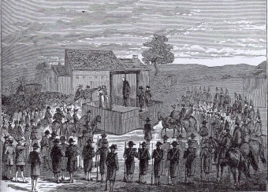
CRIMINAL PUNISHMENT : 17th Century
Public Punishment: Sentence for many offences was public hanging, or else whipping, branding, scaffold, bilboes, etc. designed to shame the person and deter others.
Prison System was not very evolved:
- Not seen as punishment: Prison was very rarely used as a punishment in its own right. It tended to be a place where people were held before their trial or while awaiting punishment.
- Houses of correction managed by Justices of Peace: Set up under the Poor Law to instil habits of industry through prison labour. They were later integrated into prison system.
- Transportation: A much-used method for disposing of convicted people was to ship them to the British colonies

Slide 3
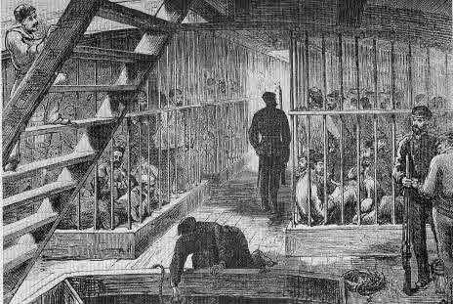
PRISON SHIPS

Slide 4
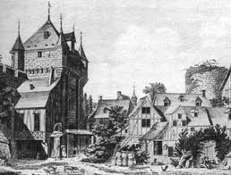
Who was in the prisons: Petty offenders, vagrants and the disorderly local poor.
No segregation: Men and women, boys and girls, debtors and murderers were all held together
No concept of care: Badly maintained and often controlled by negligent prison warders. Many people died of diseases like gaol fever, which was a form of typhus.

Slide 5

Seeds of Reform: 18th century
Transportation curtailed (late 18th century): Other sanctions had to be found.
Prison Hulks (1776-1857): For those who could do hard labour. Prison hulks were ships which were anchored in the Thames, and at Portsmouth and Plymouth. Those sent to them were employed in hard labour during the day and then loaded, in chains, onto the ship at night.
Prisons: The house of correction for those unfit for hard labour.

Slide 6
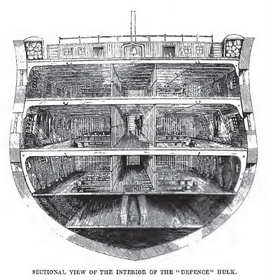
Prison Reform: The appalling conditions on the prison hulks, especially the lack of control and poor physical conditions, eventually led to the end of this practice.
The conditions on hulks did much to persuade public opinion that incarceration, with hard labour, was a viable penalty for crime.

Slide 7
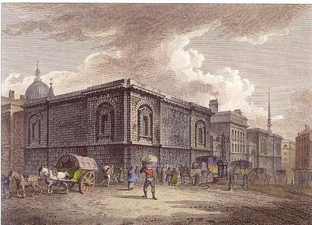
Late 18th century
18th century Rise of Debtors Prisons: Debtors were put in irons and vault rooms by jailers even before judges could give their sentence; jailers could frighten away lawyers who came to defend their clients
Mid 18th century: Imprisonment, with hard labour, was beginning to be seen as a suitable sanction for petty offenders

Slide 8

Late 18th century: Regimes of Prison Reforms
Howard League’s Call for Wide Ranging Reforms (1777): (John Howard-namesake of the Howard League) condemned the prison system as disorganised, barbaric and filthy.
- the installation of paid staff
- outside inspection
- a proper diet and other necessities for prisoners
Jeremy Bentham’s Prison Design (1791): Bentham designed the 'panopticon'. It became the model for prison building for the next half century. Each individual is seen but cannot communicate with the warders or other prisoners. The prisoner can always see the tower but never knows from where he is being observed.
- Surveillance/Hard Labour/Health-Sanitation/Segregation
Penitentiary Act (1799): This was a British Act of Parliament which introduced state prisons for the first time. Drafted by the prison reformer John Howard and the jurist William Blackstone, it recommended imprisonment as an alternative sentence to death or transportation. The Act specified that jails should be built for one inmate per cell and operate on a silent system with continuous labour.

Slide 9

19th Century: Watershed Reforms in State Punishment
Early 19th century: Prisons came to be seen as a place of reform for sinners. Public shaming was losing its popularity. Imprisonment replaced capital punishment except for offences of murder. Quakers and Evangelicals were becoming influential in prison reform and push for better prison conditions
Elizabeth Fry: English prison and social reformer in the early 19th century who was a major driving force behind new legislation to make the treatment of prisoners more humane, and she was supported in her efforts by the reigning monarch.
Dorothea Dix: Investigated prisons in the 1840s and reported to government on ill-treatment of poor and prisoners

Slide 10
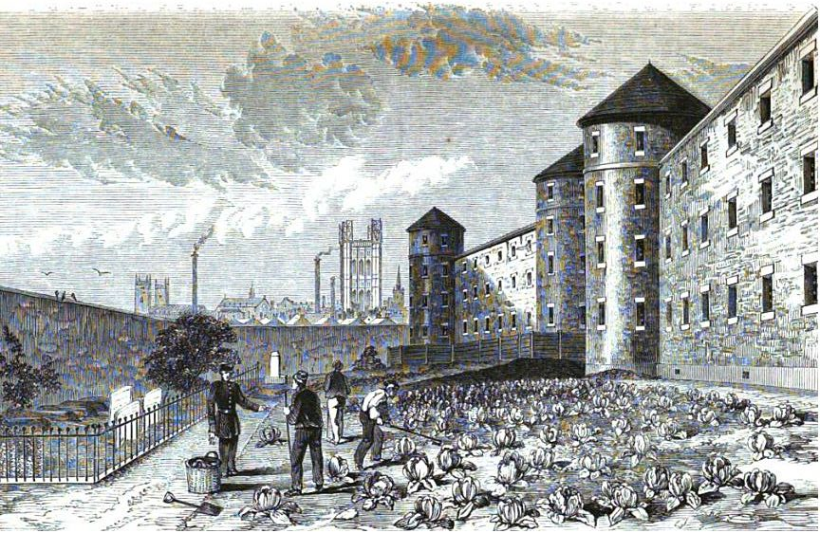
The Birth of the State Prison: The 19th century saw the birth of the state prison. The first national penitentiary was completed at Millbank in London, in 1816. It held 860 prisoners, kept in separate cells, although association with other prisoners was allowed during the day. Work in prison was mainly centred around simple tasks such as picking 'coir' (tarred rope) and weaving.
Prison Commission: In 1877 prisons were brought under the control of the Prison Commission. For the first time even local prisons were controlled centrally. At this time prison was seen primarily as a means to deter offending and reoffending. This was a movement away form the reforming ideals of the past.
Prison Act 1898: The Act reasserted reformation as the main role of prison regimes.

Slide 11
20th Century: Towards Reformation
Introduction of Borstal System for youth: This was introduced in the Prevention of Crime Act 1908. Borstal training involved a regime based on hard physical work, technical and educational instruction and a strong moral atmosphere. A young person in borstal would work through a series of grades, based on privileges, until release.
The First Open Prison: In 1933, the first open prison was built at New Hall Camp near Wakefield. The theory behind the open prison is summed up in the words of one penal reformer, Sir Alex Paterson: "You cannot train a man for freedom under conditions of captivity".
Abolition of Penal Servitude: The Criminal Justice Act 1948 abolished penal servitude, hard labour and flogging. It also presented a comprehensive system for the punishment and treatment of offenders. Prison was still at the centre of the system, but the institutions took many different forms including remand centres, detention centres and borstal institutions.
Prison Service as an Agency of government (1993): This new status allows for greater autonomy in operational matters, while the government retains overall policy direction.
Introduction of Private Prisons: The 1990s have also seen the introduction of prisons which are designed, financed, built and run by private companies. Supporters of privatisation argue that it will lead to cheaper, more innovative prisons, while organisations like the Howard League argue that private prisons are flawed both in principle and in practice.

Slide 12
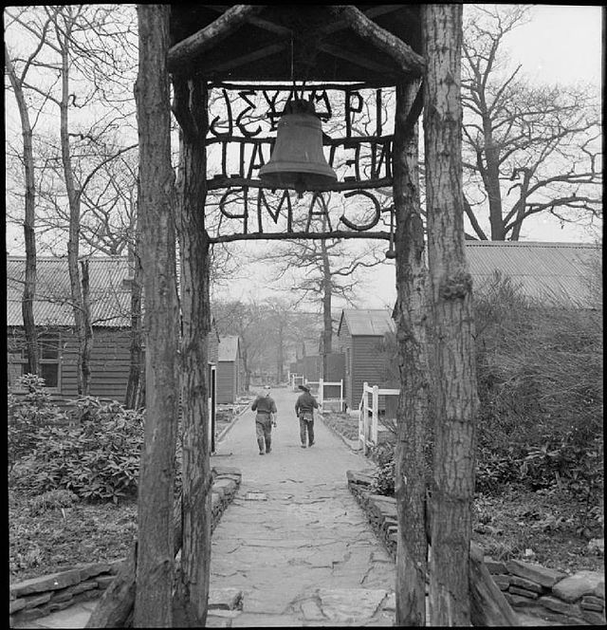
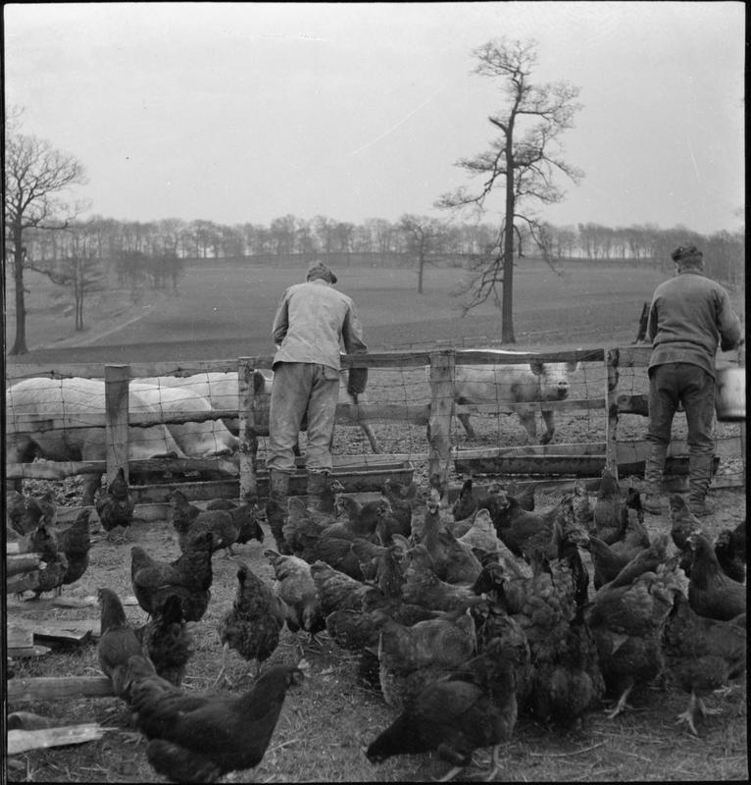
First Open Prison: New Hall Camp

Slide 13
21st Century
More Prisons: The supremacy of imprisonment as a way of dealing with offending behaviour shows no signs of abating. Privatisation increases
UN Standard Minimum Rules for the Treatment of Prisoners (1977): Stressed on ‘minimum’ conditions acceptable and to be achieved despite all the diversities in the world.
The International Covenant on Civil and Political Rights (ICCPR): Remains the core international treaty on the protection of the rights of prisoners. India ratified the Covenant in 1979 and is bound to incorporate its provisions into domestic law and state practice.
The International Covenant on Economic, Social and Cultural Rights (ICESR) states that prisoners have a right to the highest attainable standard of physical and mental health.
- Treatment as persons; Non discrimination; Prisons to maintain records and registers; maintain segregation btw men and women, between civil and criminal prisoners, men and women, undertrial and convicted, adult and young and prisoners
- Laid down standards for accomodation, bedding, hygiene, food, exercise, medical services, discipline and punishment, restraints, information to and complaints by prisoners, contact with outside world, books, religion, property, death, removal of prisoners, criteria and training of prison personnel, and inspection of prisons

Slide 14
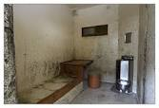
“No prisoner shall be punished unless he or she has been informed of the offences alleged against him/her and given a proper opportunity of presenting his/her defense”. Corporal punishment, by placing in a dark cell and all cruel, inhuman or degrading punishments, shall be completely prohibited as a mode of punishment and disciplinary action in the jails.

Slide 15
PRISON REFORMS IN INDIA
The modern prison in India originated with Lord Macaulay in 1835.
Prison Discipline Committee (1835): Recommended in its 1838 report the increase in rigorousness of treatment while rejecting all humanitarian needs and reforms for the prisoners.
Second Commission of Inquiry into Jail Management and Discipline (1864): Made similar recommendations as the Prison Discipline Committee
Prison Law & Draft Bill: First mention 1877
Fourth Jail Commission (1888): Recommended a consolidated prison bill. Provisions regarding the jail offences and punishment were specially examined by a conference of experts on Jail Management.
Prisons Act 1894: In 1894, the draft bill became law with the assent of the Governor General of India. This Act has hardly undergone any substantial change and continues to govern prison administration in India.
Cardew Committee (1894): The Committee asked for a body of free and unbiased observers, whose visits would serve as a guarantee to the Government and to the public, that the rules of the Prisons Act and Prison Manuals are duly observed

Slide 16
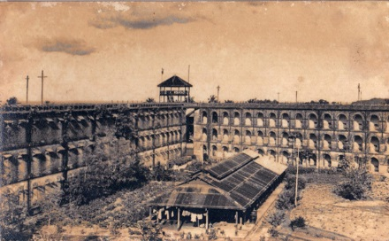
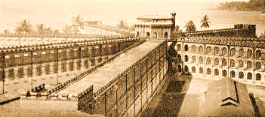
Legacy of the British

Slide 17

Shackles & The Tools of Torture

Slide 18
Indian Jail Committee (1919-20) : For the first time in the history of prisons, 'reformation and rehabilitation' of offenders were identified as the objectives of the prison administrator
Government of India Act (1935): Jails became State Subject. Disparate implementation of a national level prison policy.
Report of UN Expert (Dr W.C. Reckless ) on Correctional work (1951): His report titled 'Jail Administration in India' made a plea for transforming jails into reformation centers. He also recommended the revision of outdated jail manuals.
All India Jail Manual Committee(1957-1960) for Model Prison Manual: Recommended amendments in the Prison Act 1894 and Prison Manuals through a Model to provide a legal base for correctional work. Eg., probation, after-care, juvenile and remand homes, certified and reformatory school, borstals and protective homes, suppression of immoral traffic etc.

Slide 19

Working Group on Prisons (1972): It brought out in its report the need for a national policy on prisons and made an important recommendation with regard to the classification and treatment of offenders and laid down principles.

Slide 20
The Mulla Committee on Jail Reform (1980-1983): Made a comprehensive review of the laws, rules and regulations keeping in view the overall objective of protecting society and rehabilitating offenders.
It emphasized non-custodial measures for prisoners, and periodic review of undertrial cases.

Slide 21
The Krishna Iyer Committee (1987): Undertook a study on the situation of women prisoners in India. It has recommended induction of more women in the police force in view of their special role in tackling women and child offenders.
BPR&D Committee (1996): Basing on Ramamurthy vs State of Karnataka judgment to make prison administration uniform, the jail manual was re-drafted by the committee and accepted by the Central government and circulated to State governments in late December 2003. But States are lagging behind on this.
Draft Model Prisons Management Bill (The Prison Administration and Treatment of Prisoners Bill- 1998): This was circulated in 1999 to replace the Prison Act 1894 by the Government of India to the respective states but this bill is yet to be finalized.
Committee for the Formulation of a Model Prison Manual (2000): The Ministry of Home Affairs, Government of India, appointed a Committee for a pragmatic prison manual in order to improve the Indian prison management and administration.

