Slide 1

STEP BY STEP APPROACH
TO
LEGAL
RESERACH

Slide 2

1
Fact Analysis

Slide 3
FACT ANALYSIS
STEPS INVOLVED
To note all the factual details in an in-depth manner
STEP-1: Talk to the parties concerned & prepare detailed notes and NOT to miss any information
STEP-2: Go through the relevant documentation, eg – copy of FIR, seizure report or any other
STEP-3: Preparing the time-line of facts to refer at a later stage in the case by reading the interview notes (Step-1) & relevant documents (Step-2) number of times till you have complete clarity of the facts
STEP-4: Separate the relevant or material facts from irrelevant facts in the case

Slide 4

2
Beginning Legal Research

Slide 5
IRAC
Issue-Rule-Application-Conclusion
STEP-5: Issue means identification of the problem that is giving rise to a legal claim.
Identifying the main dispute and other disputes, if any
STEP-6: Rule means the rule of law or rules that are applicable in this case.
Research & Identify the legal provisions applicable to the facts of the case
STEP-7: Application is the stage at which you apply the issue to the rule, and assess where you stand.
Read the legal provisions very carefully
Apply the legal provisions to the issue/s in question
STEP-8: Conclusion is the stage where you determine the result of the application of the rule to the particular issue.
Clarity on facts and legal provisions, both, in support of your client and against your client

Slide 6

3
Material Sources of Law

Slide 7
PRIMARY & SECONDARY
SOURCES OF LAW
Difference: impact upon the binding nature and value of the source of law to the court
Primary source has mandatory or binding authority
Secondary source is not of mandatory authority, holds persuasive value, used in order to interpret and analyze the primary sources of law & to advance an argument more forcefully
Hierarchy in the use of sources – If unable to find a primary source, then ascertain secondary sources

Slide 8

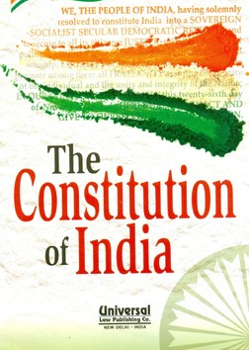
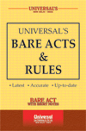
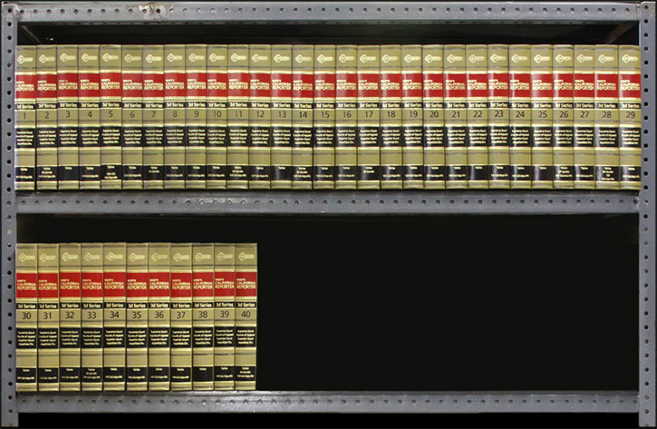
What are Primary Sources of Law?
The Constitution
Statutes
  Central legislations in Official Gazette of the GOI
  State legislations in State Gazettes
  Government websites
  Bare Acts, Manuals
Judgments decided by courts
(Stare Decisis and Precedent Value)

Slide 9
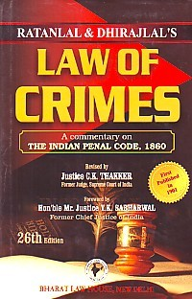
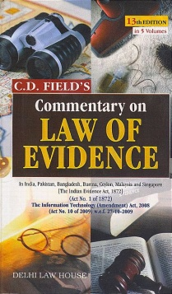



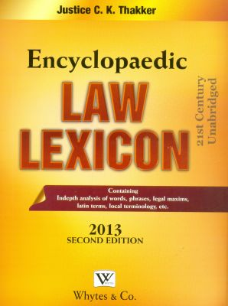
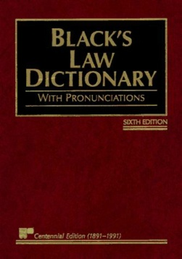
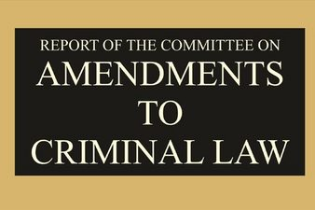
What are Secondary Sources of Law?
Commentaries on specific laws
International Treaties
Academic Journals – Indian & Foreign
Digests, Treatises, Books
Reports - Law Commission Reports; Committee/Commission Reports; Annual Reports; Parliamentary Committee Reports - Joint Committee, Select Committee & Standing Committee
Parliamentary Debates - Constituent Assembly Debates; Lok Sabha Debates; Rajya Sabha Debates
Parliamentary Bills - Lok Sabha Bills; Rajya Sabha Bills; State Legislature Bills
Legal Dictionaries/Law Lexicons
Legal encyclopedic works – eg. American jurisprudence, corpus juris secundum, Halsbury law of England, and Halsbury laws of India

Slide 10
IV. LIBRARY RESEARCH

Slide 11
STEPS TO LIBRARY RESEARCH
STEP-1: Locate the index of books / catalogue to find out the exact books & location of those books in library
STEP-2: Proceed to read and assimilate the information in the books by preparing notes
STEP-3: More research questions could be identified & Refine your questions and the issues
By following all the above steps, prepare issue-wise detailed notes of arguments and supporting case laws

Slide 12
What do you need to research & Where?
Case laws on a specific topic
Digests
Commentaries
Any particular case law
Law Reporters
Legislative intent & legislative history of any act
  Objects and Reasons of the Act (published in the bill)
  Parliamentary debates
  Law Commission Reports
  Standing Committee/ Joint/Select Committee Reports
  Reports of the Committee appointed by the ministries for enacting/ reviewing any existing enactments
Corresponding foreign law to any statutory provision in India
  Academic Journals – Indian & Foreign
  Comparative Law Journals
Meaning of any particular “word” or “phrase”
Law Lexicons / Legal Dictionaries

Slide 13
LEGAL SOURCES
COMMENTARIES ON CONSTITUTIONAL LAW
Seervai H.M. | Constitutional Law of India : A Critical Commentary (Bombay: N.M. Tripathi Pvt. Ltd.)
Basu D.D. | Shorter Constitution of India (Nagpur: Wadhwa & Co.)
Jain M.P. | Indian Constitutional Law (Nagpur: Wadhwa & Co.)
Datar Arvind P. | Commentary on the Constitution of India (Nagpur: Wadhwa & Co.)
COMMENTARIES ON INDIAN PENAL CODE
Batuk Lal & Nakvi S.K.A. | Commentary on the Indian Penal Code (New Delhi: Orient Pub. Co.)
Ratan Lal & Dhiraj Lal | Law of Crime: A Commentary on Indian Penal Code 1860 (New Delhi: Bharat Law House)
Gour Hari Singh | Commentaries on the Indian Penal Code (Allahabad : Law Publishers)
COMMENTARIES ON EVIDENCE
Monir M. | Law of Evidence (Delhi: Universal Law Pub. Co.)
M.C. Sarkar & Ors. | Law of Evidence in India, Pakistan, Bangladesh, Burma & Ceylon (Nagpur; Wadhwa & Co.)
IMPORTANT DIGESTS
Surendra Malik | Supreme Court Yearly Digest (Lucknow: E.B. Co.)
 | Complete Digest of Supreme Court Cases (Lucknow: E.B. Co.)
 | Supreme Court Millennium Digest (Nagpur: AIR Publications)

Slide 14
LEGAL SOURCES
ACADEMIC LAW JOURNALS
Annual Survey of Indian Law (New Delhi: ILI)
Journal Indian Law Institute
Journal of Constitutional & Parliamentary Studies
Indian Journal of International Law
Indian Bar Review
National Law School of Indian Review
Journal of Human Rights (NHRC)
LAW LEXICONS
Aiyar Ramanatha P. | Advanced Law Lexicon: Encyclopedia Law Dictionary with Legal Maxims, Latin Terms and Words & Phrases (Nagpur: Wadhwa & Co.)
Aiyar K.J. | Judicial Dictionary (New Delhi: Butterworths India)
Prem, Daulat Ram | Judicial Dictionary (Jaipur: Bharat Law Publications)
 | Legal Glossary published by Ministry of Law, Justice & Co. Affairs
ENCYCLOPEDIC REFERENCE SOURCE
Halsbury’s Laws of India, Approx 30 Vols. (New Delhi: Butterworths )

Slide 15
CASE LAW RESEARCH

Slide 16
Ratio Decidendi and Obiter Dictum
Ratio Decidendi – BINDING – reasoning that is used in the judgment that correlates the facts and the law, and upon analysis determines the outcome of the dispute
Obiter Dictum – NOT BINDING – an observation, reference or discussion and is not central to the decision or determination of the dispute
A lawyer must be able to separate the obiter from the ratio decidendi and reliance must be placed on the ratio
Distinguished Cases: In case Court finds that the ratio has been on the basis of different facts or situation, then that case is distinguished from the present case before the court and will thus not have to follow the prior decision.

Slide 17
example

Slide 18
LAW REPORTERS
Most widely used and easily available:
Supreme Court Reporter SCR
All India Reporter AIR
Supreme Court Cases SCC
Scale (Supreme Court judgments) SCALE
Criminal Law Journal CrLJ
LABOUR/MATRIMONIAL
Numerous reporters are specific to each state. All India Reporter publishes volumes for the states. For example, A.I.R (A.P) refers to Andhra Pradesh High Court judgements.

Slide 19
List Of Rajasthan Law Journal/Reporter
NAME OF JOURNAL/ REPORTER | AVAILABILITY
Rajasthan Criminal Cases | Raj, Raj(JB)*
Rajasthan Dandik Nirnaya Patrika | Raj
Rajasthan Judgement Criminal | Raj
Rajasthan Law Times | Raj, Raj(JB)
Rajasthan Law Reporter | Raj, Raj(JB)
Rajasthan Law Weekly | Raj, Raj(JB)
Rajasthan Revenue Decision | Raj, Raj(JB)
Rajasthan State Current Statutes | Raj, Raj(JB)
Rajasthan Vidhi Patrika | Raj
Rajasthan Criminal Decision | Raj
Rajasthan Digest Monthly | Raj
Rajasthan Accident Reporter | Raj
*Raj(JB) – Jaipur Bench

Slide 20
How to read a citation?
Example 1: 1997 A.I.R (SC) 3011
Year of the Case: 1997
Name of the law reporter: A.I.R. (All India Reporter)
Name of the Court: SC (Supreme Court)
Page Number: 3011
Example 2: 1979 SCR (3) 532
Year of the Case: 1979
Name of the law reporter: SCR (Supreme Court Reader)
Name of the Court: SC (Supreme Court)
Volume Number: 3
Page Number: 532

Slide 21
How to read a case?
Head Notes: Highlights of the judgment, good reference to find out in short what the judgment deals with but at times erroneous
Must always refer to the original case, and not place reliance only upon the interpretation of the case by the author of the article or book

Slide 22
INTERNET RESEARCH

Slide 23
SOURCES OF INTERNET RESEARCH
India Code: This provides access to all the Central legislations as provided by Legislative Department of Ministry of Law.
Court Web Sites: This provides links to the websites of the high court and some district courts.
  Causelists: Contains information regarding causelists, including weekly lists, advance lists, daily lists and supplementary lists of the Supreme Court and high courts.
  Daily Orders: It provides the latest daily orders of the Supreme Court and high courts.
  Courtnic: The current status of any case, i.e. information of all pending and disposed cases including next date of listing, date of disposal, etc, is easily available on this site. It also provides the text of latest orders.
  Judgement Information System: This website contains the cases that are decided by the Supreme Court of India but may not find all the cases. (http://www.judis.nic.in/)

Slide 24
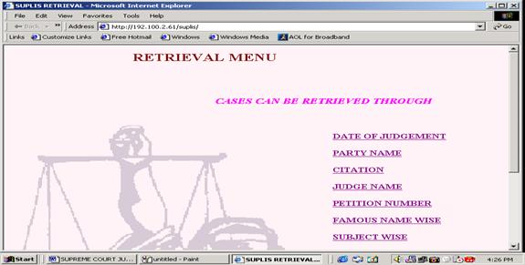
SUPLIS (Database of Case Laws)
SUPLIS is an indexing database of case laws decided by the honorable Supreme Court. This database consists of more than 42,000 case laws since 1950.
Besides retrieval of case laws by subject and case title, it also provides search capability by a “famous case name” (if any) assigned at the time of the entry – for example: “Bhopal Gas Case”, “Rajiv Gandhi assassination case,” “Mandal Commission Case,” etc.
Provides “equivalent citations” of case laws

Slide 25

SUPLIB (Database of Legal Articles)
SUPLIB is a database of legal articles published in about 200 foreign and Indian law reports
After receipt of a journal in the library, important articles are identified, indexed, and entered in this database under all possible subject headings.
SUPREME COURT JUDGES LIBRARY
LEGAL ARTICLES RETRIVAL SYSTEM
SUBJECT WISE
JOURNAL WISE
TITLE WISE
AUTHOR WISE

Slide 26
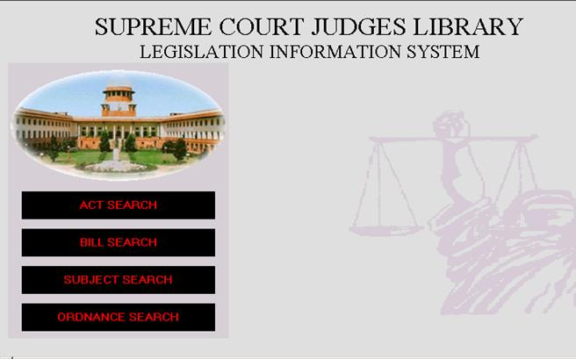
LEGISLATION INFORMATION SYSTEM
The Legislative Database is a database for central government acts including amendments, rules, bills, and all subordinate legislations relating to central as well as state acts.

Slide 27
Other Legal Websites
S.No. | WEBSITE | INFORMATION | SUBSCRIPTION TYPE
1. | http://www.lawadiv.com | General law site | Free requires registration
2. | http://www.indiacorporateadvisor.com | Corporate law, foreign exchange and tax laws | Requires Subscription
3. | http://indianlegaleagle.com | General law site | Free requires registration
4. | http://www.indiaitlaw.com | Information Technology law | Free requires registration
5. | http://supremecourtcaselaw.com | Supreme Court and High Court judgements | Requires Subscription
6. | http://www.legalservicesindia.com | General law site | Free requires registration
7. | http://www.indlaw.com | General law site | Requires Subscription
8. | http://lexsite.com | Corporate law, foreign exchange and tax laws | Requires Subscription
9. | http://mahalibrary.com | Statute law | Free requires registration
10. | http://www.vakilno1.com | General law site | Free
11. | http://www.taxnyou.com | Articles on Income Tax | Free
12. | http://www.laws4india.com | General law site | Requires Subscription
13. | http://www.lawchips.com | Links to legal sites | free
14. | http://www.lawguru.com | General law site | Free
15. | http://www.courtsjudgements.com | Supreme Court and High Court judgements | Requires Subscription
16. | http://www.manupatra.com | General law site | Requires Subscription
17. | http://www.ib-net.com/links/govt.htm | links to important law sites | free
18. | http://www.companylawinfo.com | Corporate law | Requires Subscription
19. | http://www.indiacorporateadvisor.com | Corporate law, foreign exchange and tax laws | Requires Subscription

Slide 28
Other Legal Websites
S.No. | WEBSITE | INFORMATION | SUBSCRIPTION TYPE
1 | http://indiankanoon.org/ | Supreme Court and High Court judgements | Free
2 | http://www.lawadiv.com | General law site | Free requires registration
3 | http://www.indiacorporateadvisor.com | Corporate law, foreign exchange and tax laws | Requires Subscription
4 | http://indianlegaleagle.com | General law site | Free requires registration
5 | http://www.indiaitlaw.com | Information Technology law | Free requires registration
6 | http://supremecourtcaselaw.com | Supreme Court and High Court judgements | Requires Subscription
7 | http://www.legalservicesindia.com | General law site | Free requires registration
8 | http://www.indlaw.com | General law site | Requires Subscription
9 | http://lexsite.com | Corporate law, foreign exchange and tax laws | Requires Subscription
10 | http://mahalibrary.com | Statute law | Free requires registration
11 | http://www.vakilno1.com | General law site | Free
12 | http://www.taxnyou.com | Articles on Income Tax | Free
13 | http://www.laws4india.com | General law site | Requires Subscription
14 | http://www.lawchips.com | Links to legal sites | free
15 | http://www.lawguru.com | General law site | Free
16 | http://www.courtsjudgements.com | Supreme Court and High Court judgements | Requires Subscription
17 | http://www.manupatra.com | General law site | Requires Subscription
18 | http://www.ib-net.com/links/govt.htm | links to important law sites | free
19 | http://www.companylawinfo.com | Corporate law | Requires Subscription
20 | http://www.indiacorporateadvisor.com | Corporate law, foreign exchange and tax laws | Requires Subscription

